Slide 1
Multi-trait polygenic score generation
Updated tagging file
Notes:
Work in progress
Would love Opinions!
Rick A. Reijnders¹, Ghazi Al Jowf, Ehsan Pishva, (Utrecht team), Laurence de Nijs, Lars M.T. Eijssen, Bart P.F. Rutten
¹ Department of Psychiatry and Neuropsychology, School for Mental Health and Neuroscience (MHeNS), Maastricht University, Maastricht, The Netherlands
² Department of Bioinformatics—BiGCaT, Maastricht University, PO Box 616, 6200 MD Maastricht, The Netherlands

Slide 2
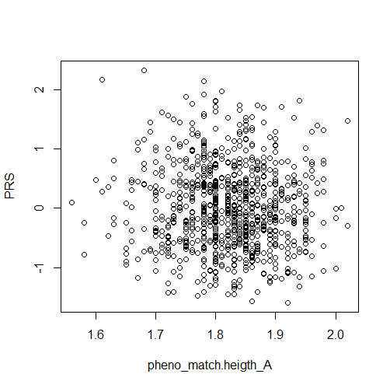
PGS height
PRISMO
Generated using 1000Genomes reference
Using subset of provided GWAS height example

Slide 3
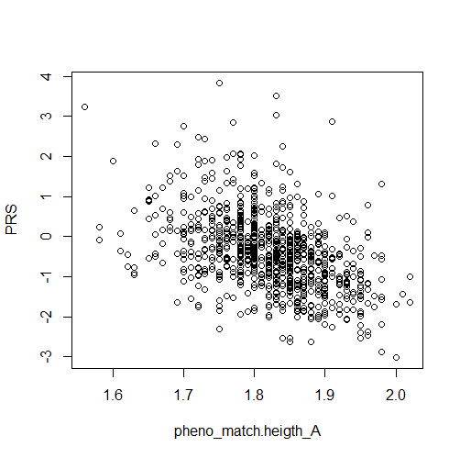
PGS height
PRISMO
Generated using UK biobank precomputed reference file
Using full set of GWAS height 2022 by Yengo et al

Slide 4
PGS height
PRISMO
Generated using UK biobank precomputed reference file
Using full set of GWAS height 2022 by Yengo et al
SNPs: 958,378

Slide 5

PGS height
PRISMO
Generated using UK biobank precomputed reference file
Using full set of GWAS height 2022 by Yengo et al
SNPs: 047,918 (5%)

Slide 6
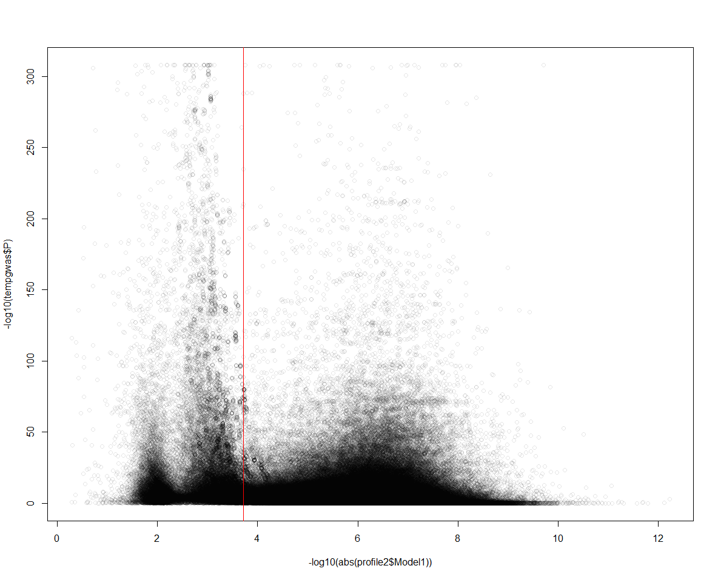
Significance in GWAS
Effect of each SNP

Slide 7
High sign
High effect
High sign
Low effect
Significance in GWAS
Low sign
High effect
Low sign
Low effect
Effect of each SNP

Slide 8
5% of all SNPs
Significance in GWAS
Effect of each SNP

Slide 9
5% of all SNPs
Basically, should not cut on significance
Significance in GWAS
Effect of each SNP

Slide 10
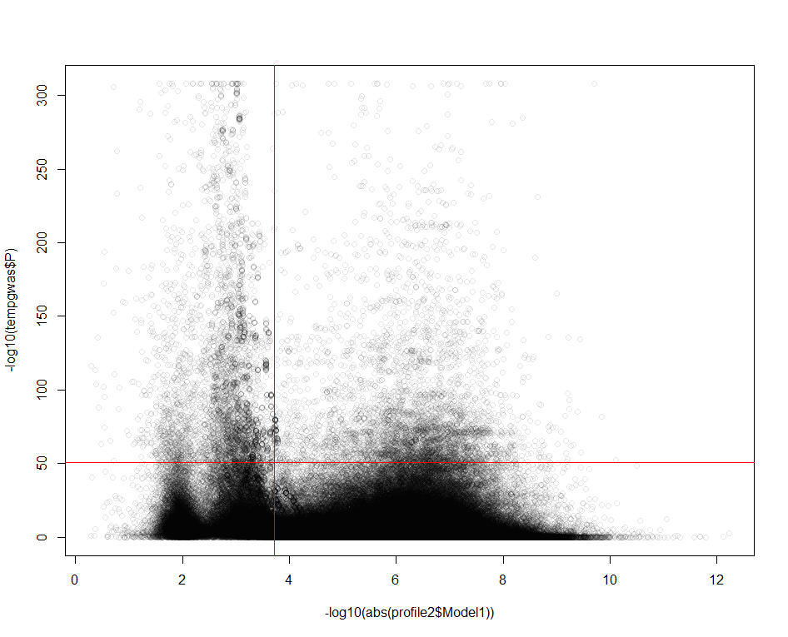
5% of all SNPs
Basically, should not cut on significance
If we did, it would be something like this
Significance in GWAS
1% of all top sign SNPs
P ~ 1e-50
Effect of each SNP

Slide 11
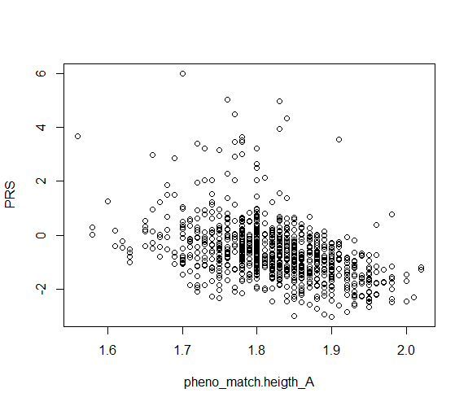
PGS height
LDpred
Called from LDAk

